Slide 1
Video & Data Solutions Provider for Public Transit & Schools
Investor Presentation Aug 2022
TSX-V: GSI | OTC: GKPRF

Slide 2
DISCLAIMER ON FORWARD LOOKING STATEMENTS
This presentation contains “forward-looking information” within the meaning of applicable Canadian securities legislation. Forward-looking information may include, but is not limited to, information with respect to the developments in Gatekeeper’s operations in future periods, the adequacy of Gatekeeper’s financial resources, costs and timing of development and Gatekeeper’s executive compensation approach and practice. When ever possible, words such as “plans”, “expects”, or “does not expect”, “budget”, “scheduled”, “estimates”, “forecasts”, “anticipate”, or “does not anticipate”, “believe”, “intend”, and similar expressions or statements that certain actions, events or results “may”, “could”, “would”, “might” or will be taken, occur or be achieved, have been used to identify forward-looking information.
Forward-looking information is subject to a variety of known and unknown risks, uncertainties and other factors that could cause actual events or results to differ from those expressed or implied by the forward-looking information, including, without limitation, those described under “Risk Factors” in the Prospectus and the following: reduced spending by the Corporation’s customers that result from changes in spending policies or budget priorities; the Corporation’s ability to manage risks inherent in foreign operations; the Corporation’s ability to protect its brand; the Corporation’s ability to obtain products and parts from suppliers on a timely basis and on favorable terms; the Corporation’s ability to manage its manufacturing and logistical services successfully; the reliability of product manufacturing and assembly and logistical services provided by third parties; possible changes in the demand for the Corporation’s products; the Corporation’s ability to successfully execute its business strategies; the Corporation’s ability to establish new relationships and to build on its existing relationships with integrators and dealers; and the Corporation’s ability to manage cash flow, foreign exchange risk and working capital.
This list is not exhaustive of the factors that may affect any of the Corporation’s forward-looking information. Although Gatekeeper has attempted to identify important factors that could cause actual results to differ materially from those contained in forward-looking information, there may be other factors that cause results not to be as anticipated, estimated or intended. There can be no assurance that such information will prove to be accurate, as actual results and future events could differ materially from those anticipated in such information. Forward-looking information involves statements about the future and is inherently uncertain, and Gatekeeper’s actual achievements or other future events or conditions may differ materially from those reflected in the forward-looking information due to a variety of risks, uncertainties and other factors, including, without limitation, those referred to in the Prospectus under the heading “Risk Factors” and elsewhere in the Prospectus. Gatekeeper’s forward-looking information is based on the beliefs, expectations and opinions of management on the date the statements are made, and the Corporation does not assume any obligation to update forward-looking information, whether as a result of new information, future events or otherwise, other than as required by applicable law. For the reasons set forth above, prospective investors should not place undue reliance on forward-looking information.
This presentation is not, and is not intended to be, an offer to sell or the solicitation of an offer to buy any security of Gatekeeper in any jurisdiction. This presentation is not an offering memorandum.

Slide 3
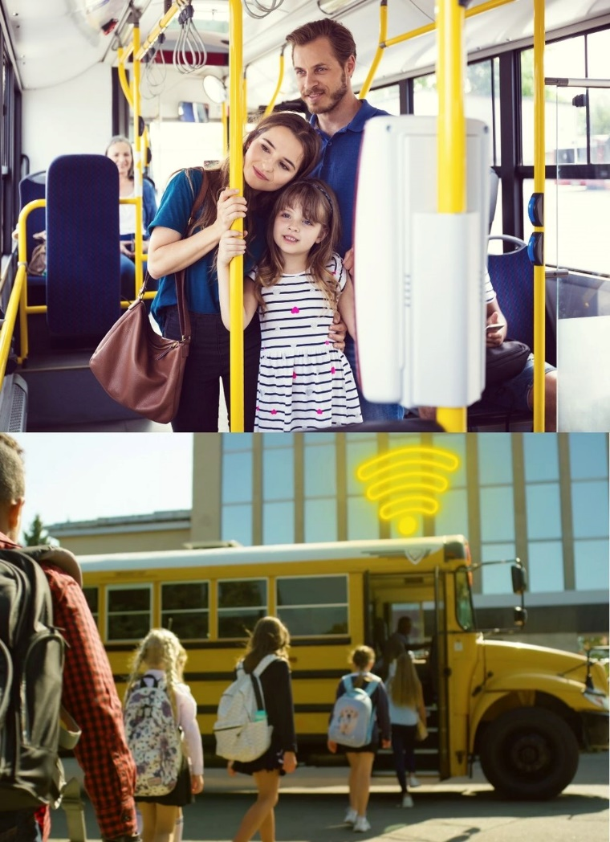
VIDEO & DATA SOLUTIONS PROVIDER FOR PUBLIC TRANSIT & SCHOOLS
1
2
3
Established, emerging data company
Data devices & video surveillance on public transportation vehicles
40,000 intelligent mobile data collector units installed
3,500 customers
AI, video analytics, data – key growth drivers
Data Cities are embracing technology in transit solutions post-COVID
“Black-box” for buses & trains to improve safety and aid accident investigations
Video monitoring & enforcement are now a necessity
Platform-as-a-Service (PaaS) business model
Onboard data platform for intelligent transportation in smart cities
New technology solutions can be layered on PaaS platform
4
5
Growth inflection point
$15M/yr Revenue (TTM, FQ3 2022)
Strong sales backlog
Compelling valuation
$27M market cap
$9M working capital,

Slide 4
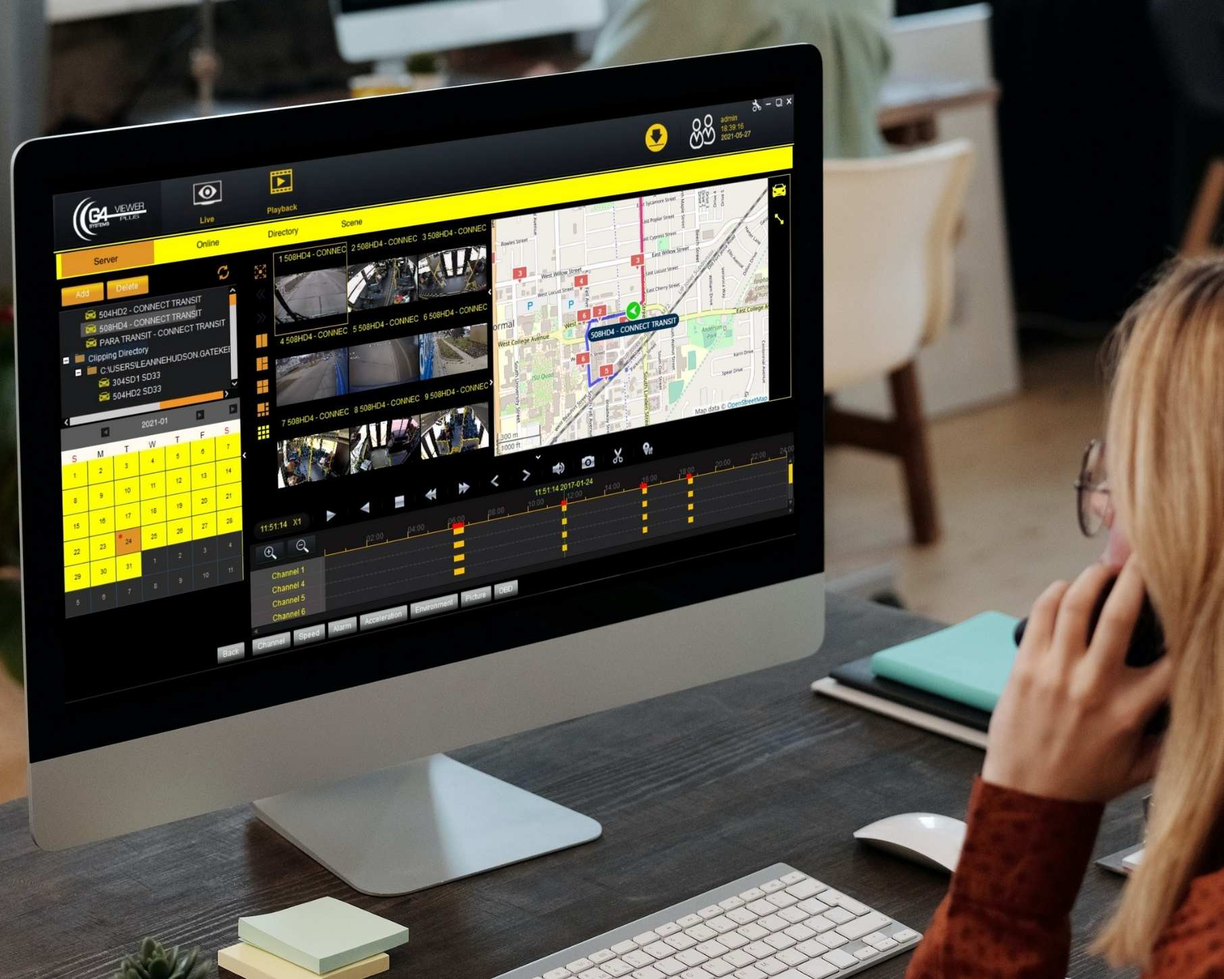
VIDEO ANALYTICS & DATA SOLUTION
Video now dominates in passenger transportation
80% of transit buses have video
Increasing reliance on video for enforcement / fraud prevention
Hi-def IP cameras create enormous amounts of video data
Difficult to wirelessly transmit, store, and monitor
Video data is now too extensive to manage manually
1
Gatekeeper cloud-based video analytics software
• Event-driven video capture (e.g. erratic driving behavior)
• Alarm notification when camera image is covered/compromised
• Video compression algorithms
• ‘System Health Check’ reports, for active system maintenance
• Snippet capture, facial blurring, allows video segments to be
easily emailed
2
Gatekeeper processes video data “at the edge”
• On-vehicle mobile data collectors & video processing

Slide 5
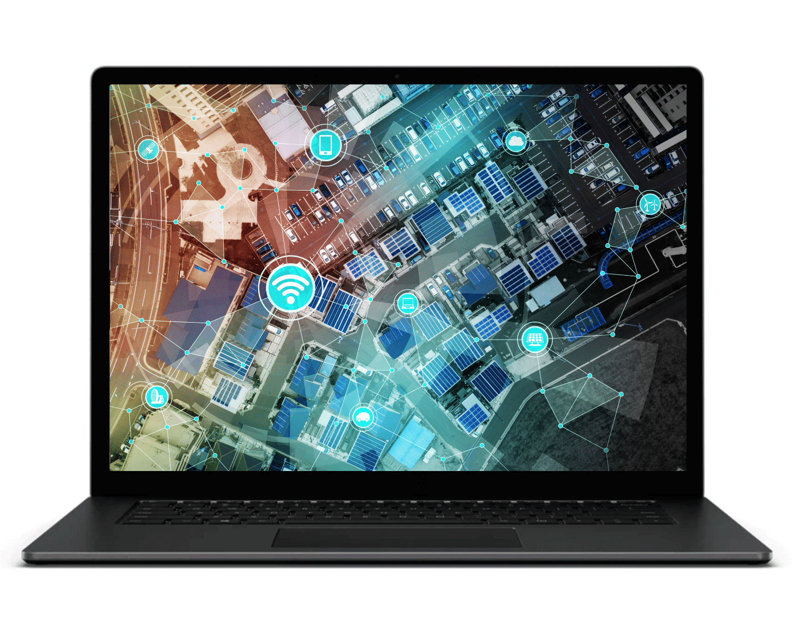
PLATFORM-AS-A-SERVICE (PAAS) BUSINESS MODEL
Gatekeeper is the “computer on-board” municipal vehicle assets and school bus fleets
Over 40,000 intelligent mobile data collectors installed
Data platform for Smart Cities & Intelligent Transportation
On-vehicle digital recording devices (DVRs), GPS enabled, multiple data points, video, alarms, analytics
Wirelessly connected, bi-directional data to a moving vehicle
Video analytics for illegal vehicle passing, license plate capture, ticket issuance
Transit-lane violation enforcement, passenger counting, evidence management and infraction ticketing
Remote monitoring & management of vehicle assets
Adding new data layers
Thermal cameras, contact tracing, touchless fare payment
Mobile Wi-Fi system for school bus
Bus lane infraction enforcement
Important since increases in Uber/taxi drop-offs in the bus lanes impedes public transit efficiency

Slide 6
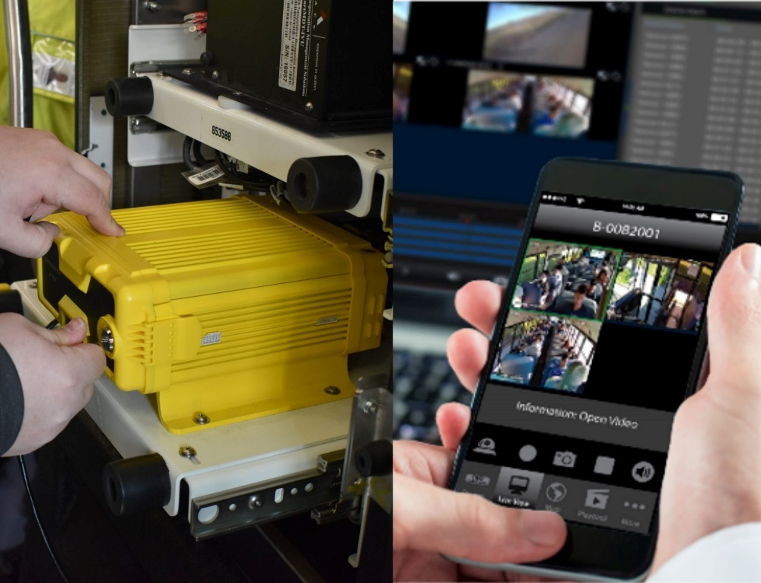
INTELLIGENT MOBILE DATA COLLECTORS
40,000 data collectors installed
On school buses, transit buses and trains
Collecting vehicle data such as video, audio, GPS, time, door open/close
Ruggedized, crashworthy DVRs
8 TB of video storage recording 24 high-def IP cameras Collecting vehicle data such as video, audio, GPS, time, door open/close,
Serve as the "black box" to aid in transit accident investigations
Wireless Connectivity
Wi-Fi enabled, mobile connected, or mobile enabled , allowing public transport assets to become part of the intelligent transportation solution in a Smart City ecosystem

Slide 7
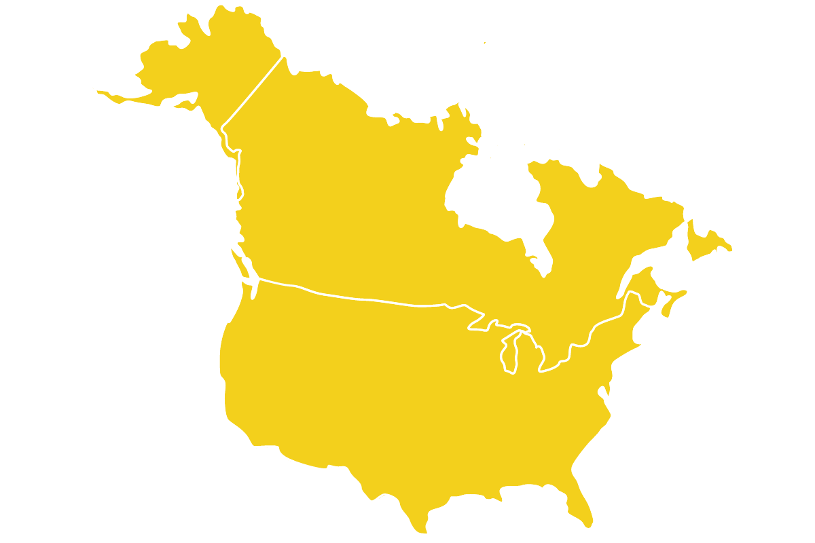
SCHOOL BUS INDUSTRY: READY FOR TECHNOLOGY UPGRADE
Department of Education
$122 Billion to be spent to help schools reopen safely
March 17, 2021 (ed.gov news)
In the US, 480,000 yellow school buses transport 22.6 million students daily
Driving approximately 3.4 billion miles annually, transporting 49% of total public student
40,000 new school buses annually
Limited technology improvements in past 30 years when compared to auto improvements
3,500
Gatekeeper has 3,500 school districts as customers
40,000
Gatekeeper has 3,500 school districts as customers
Customers in every state and province in North America
Well established CRM system, contact data for all 13,000 school districts, 70,000 database customer contacts
Gatekeeper has significant industry experience
40,000 intelligent Mobile Data Collectors installed
100,000 in-vehicle video device installations
Every year 40,000 new school buses are manufactured
480,000
In the US, 480,000 yellow school buses transport 22.6 million students daily

Slide 8
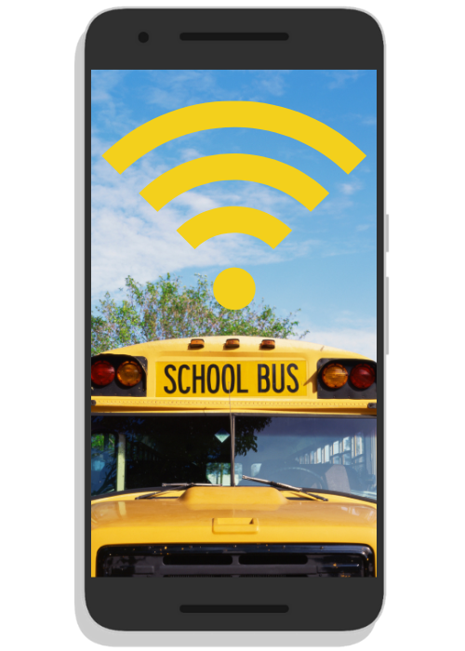
SCHOOL BUS MOBILE Wi-Fi SYSTEM
Wi-Fi Solutions
Turn school buses into mobile Wi-Fi hotspots with Gatekeeper’s Mobile Wi-Fi System (MWS)
Internet access is available on school buses to the vehicle is in motion or parked
MWS enabled school buses can be parked and provide internet in underserved communities
Gatekeeper’s MWS is routed through the school’s firewall and content filter, providing a safe internet experience for students
Wi-Fi Benefits
MWS enabled buses help to close the digital divide so all students have access to the tools they need to succeed
Leverage the average of 180 hours spent on the school bus each year by allowing students to access research material to complete assignments
School buses with MWS can also be configured to provide remote access to video cameras, DVR storage, and GPS location
Cellular Connectivity
Helping Students
Gatekeeper’s All in one mobile modem provides Wi-Fi and Cellular connectivity
Over 30% of students do not have adequate internet at home

Slide 9
SCHOOL BUS INTERIOR CAMERAS
Capture Every Moment
• Record HD video and audio
• Use Gatekeeper’s Wide Angle Cameras
to capture every angle
Keeping Children Safe
• Prevent incidence of bullying and
vandalism
• Safeguard children’s privacy with
facial blurring technology
Internal camera view
with facial blur feature

Slide 10
SCHOOL BUS STUDENT PROTECTOR
Capture every detail of a stop-arm infraction
There are nearly 17 million school bus stop-arm violations per year in the US alone
There is nearly one stop-arm violation per bus per school day on average.
1
Automatically capture every violation
High-speed, multi-lane license plate reader to capture stop-arm violators, in any conditions, day or night
2
Create citations easily
Video analytics software allows districts to issue tickets automatically
Web-based citation management system provides full control of a citation from its creation to its payment.

Slide 11
v
CLARITY™
1
School bus management software solution
Scheduling, on-bus video, and data analysis tools to manage the logistics of school bus operations
Helps enable flexible, safe and efficient transportation
2
Dispatch & Payroll
Connects to mobile data collectors & video devices to integrate data elements such as GPS location, passenger counting, and video analysis
Quick and easy audit of scheduled time vs. actual time vs. paid time for each task
3
Logistics solutions
Manage staff shortages with Flex-schedules, hybrid schooling and route optimization
4
Bytecurve
Developed in partnership with ByteCurve
Established technology provider for school bus transportation which has been embraced by a global leading transportation provider

Slide 12
TRANSIT MARKET: SIGNIFICANT GROWTH DRIVER
80%
of transit buses now have video cameras
20-28%
improvement in peak congestion travel times with transit-only lanes
$108 Billion
in U.S. federal funding announced in 2021
$20 Million +
In transit revenue for Gatekeeper
Video-based evidence for transit, bus & rail
Transit authorities embracing emerging technologies
Increased transit funding within $1.2 trillion Bipartisan Infrastructure Deal
Gatekeeper entered the transit market in 2018
Public Transit Authorities embracing video surveillance solutions to reduce fraudulent claims and improve passenger safety
183,000 transit vehicles in US
19,000 transit vehicles in Canada
Bus lane infraction cameras
License plate capture of vehicles illegally passing buses/street cars while passengers are loading/unloading
Passenger counting
Intelligent routing
In that time the company has generated over $20 million in revenue from the transit industry
Over 10,000 transit vehicles to be upgraded

Slide 13
STRATEGIC TRANSIT CUSTOMER: SEPTA
Southeastern Pennsylvania Transportation Authority
6th largest transit authority in the US
Ridership of over 300 million passenger rides annually
3,600 vehicles including approximately 970 trains
1 MILLION DAILY PASSENGER TRIPS
1
SEPTA - a leading transit authority in use of video
Actively using vehicle video surveillance to evaluate and defend claims, monitor system safety and security, and protect against fraud
US$22M/yr. savings in false liability claims by using video evidence
Sophisticated video-evidence installation
Over 27,000 video cameras installed on vehicles & stations
2
SEPTA chose Gatekeeper for its software, video analytics, specialized DVRs
~$20M in new-business revenue contribution since 2018
Recurring services contract $2.36M/yr, up to $11.8M (initial 3 yr term, 2 yr extension option)

Slide 14
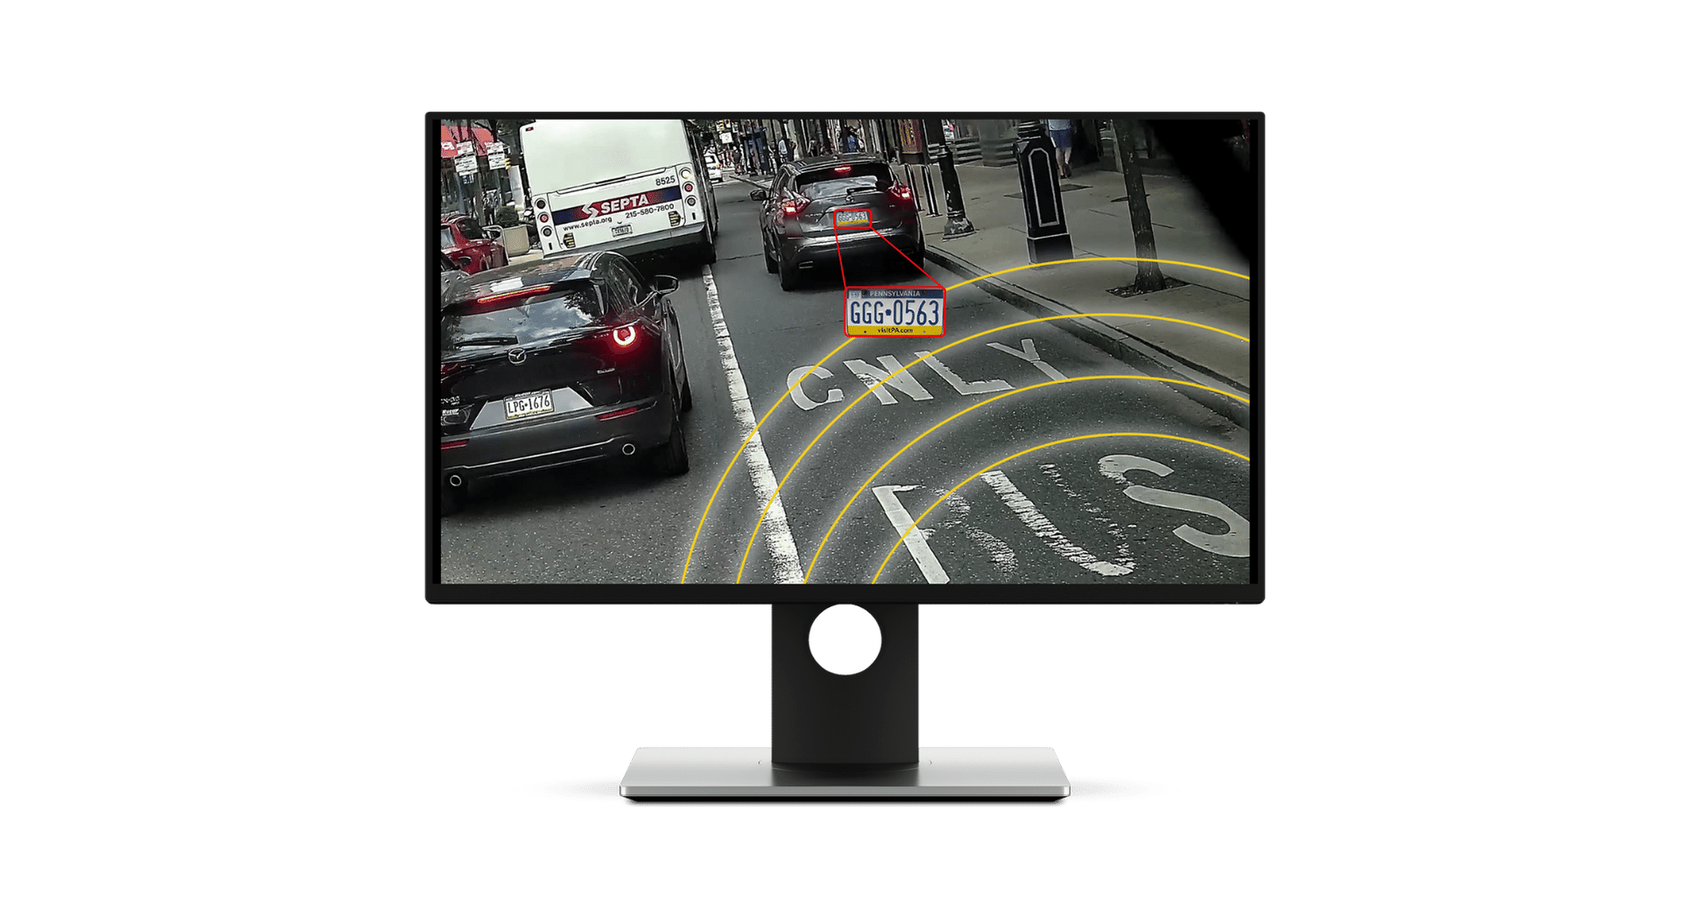
AUTOMATED LANE ENFORCEMENT (ALE)
Reduce transit lane violations
Custom-designed for transit applications
Launched July 2021
AI and Video Analytics
Captures vehicle license plate of lane violations
Large market opportunity
Traffic congestion in cities is a concern, post-pandemic due to user preference toward ride-hailing vehicles vs. transit
Currently conducting live transit trials
Includes specialized applications
Vehicles partially obstructing the bus lane
Vehicles in the bus lane that signal a legal right-hand turn, but illegally continue to drive straight
Vehicles passing streetcars when passengers are boarding or deboarding

Slide 15
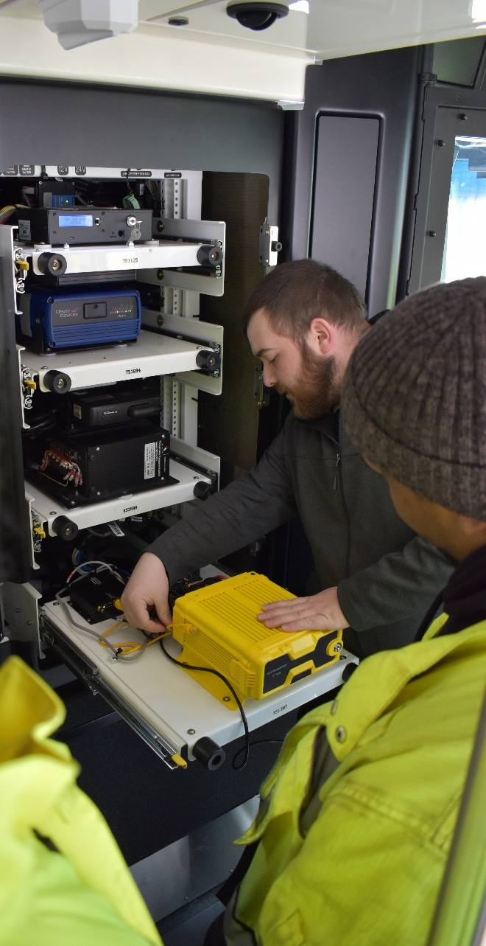
“BLACK BOX” RECORDERS FOR TRAINS
National Transportation Safety Board wants all rail transit vehicles equipped with inward and outward facing cameras
Digital video recorders to record minimum 12 hours of video, data, audio/voice and video
Identified them as being critical to improve operational safety and aiding in accident investigations
NTSB recommendation here
1
2
Significant market opportunity for Gatekeeper
“Black-box” for trains, transit and buses
Designed to meet EN50155 international standards for electronics on passenger trains
Gatekeeper – proven technology provider
Gatekeeper contracted by SEPTA to supply & install DVRs on trains
$6.3 million contract, completed Oct 2020

Slide 16
INTELLIGENT TEMPERATURE SENSING SYSTEMS
Passenger health monitoring
Custom-designed for public transportation applications, which require high speed, high accuracy
Uses thermal cameras, artificial intelligence, and video analytics
Visual and audible alarms are triggered when temperature thresholds are exceeded
1
Facial recognition capabilities
Prepares for future applications such as intelligent passenger routing, contact tracing, passenger counting, or payment verification
Records facial images within 40 milliseconds, storage capacity of 50,000 images
2
Passenger Mask Detection

Slide 17
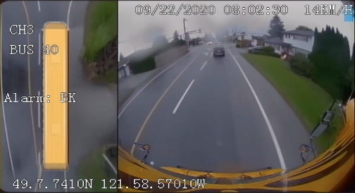
EXTERIOR VIDEO SOLUTIONS
Safer transportation for passengers and drivers
Protect drivers against lawsuits, false liability claims, violence, vandalism, road rage, and theft
Eliminate blind posts with 360° surround vision
Help in training new drivers, monitoring driver behavior, and coaching the driving habits of company drivers
Driver performance monitoring (speed, swerving, braking)
Cameras built to withstand extreme weather conditions
Allows fleet managers to:
View live-streaming video to assess emergency situations,
View historical data
Systems are equipped with driver alert button which automatically uploads corresponding video & alarm to monitoring center
Video is synchronized with GPS location, improving incident response times

Slide 18
ENABLING SMART CITIES: AI & ANALYTICS
Intelligent transit planning
Analytics is becoming increasingly important
Collecting and analyzing data is essential for maximizing resources and improving services
Protecting passengers
Temperature checking, contact tracing
Video evidence, flagging abnormal passenger behavior
People counting, facial recognition
Interconnecting passenger-transport vehicles
Wirelessly connected on-board data collectors
Intelligent routing
Surveillance
Improving traffic flow
Efficient public transit
Safer, smarter communities
Transportation solutions for public transit and schools is complex, and each community has their own needs and challenges
Gatekeeper’s AI & video analytics solutions helps communities plan and improve services with data-driven decisions specific to their needs

Slide 19
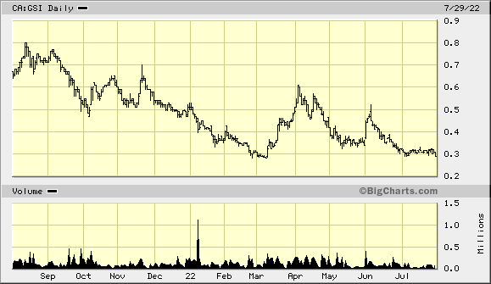
FINANCIAL INFORMATION
9mo
Shares Outstanding | 91.4 M
Stock Options | 7.9 M
Fully Diluted Shares | 99.3 M
Market Cap (@ $0.30/sh) | ~$27 M
FY 2021, Aug 31, 2021
Revenue | $17.2 M
Operating Profit | $ 0.7 M
9mo YTD May 31, 2022:
Revenue | $ 10.2 M
Working Capital | $ 8.6 M
$8M revolving credit facility in place with TD Bank
Insider ownership ~ 14%
1 Year stock chart (GSI: TSX-V)

Slide 20
BOARD OF DIRECTORS
 | Doug Dyment DIRECTOR & CHAIRMAN | Founded Gatekeeper Systems in 1997 and took the company public 2013 Former VP Marketing and Director at Silent Witness; founded Security Products Division
 | Colin Sutherland DIRECTOR | Chartered Professional Accountant, 20 years of executive experience in companies with international operations C-suite involvement in over $2 billion of corporate financings, mergers, and acquisitions. Executive roles in four companies with dual listings on both the Toronto Stock Exchange and a major US stock exchange
 | Corey Muirhead DIRECTOR | Executive Vice President of Logan Bus Company Inc. President of the New York School Bus Contractors Association Lead negotiator on over $1 billion in contracts with NYC Dept of Education & government agencies
 | David Stumpo DIRECTOR | Founder & CEO of the American Public Transit Exams Institute (APTREX) Former CEO Coast Mountain Bus (Formerly BC Transit) and San Francisco Municipal Railway (MUNI) Executive Director for the Southern California Regional Transit Training Consortium (SCRTTC). 40 years’ experience within the public transit industry

Slide 21
SENIOR MANAGEMENT
 | Doug Dyment PRESIDENT / CEO | Founded Gatekeeper Systems in 1997 and took the company public 2013 Former VP Marketing and Director at Silent Witness; founded Security Products Division
 | Kelsey Chin CGA, CPA CHIEF FINANCIAL OFFICER | Chartered Professional Accountant who has served as CFO for numerous publicly listed companies Ms. Chin is intricately familiar with accounting principles, analyzing and preparing financial statements
 | Doug Fraser P. Eng, MBA VP PROGRAMS & PRODUCTS | Former global product manager for Honeywell, specific technology included network infrastructure, wireless integration including WIFI and MESH networks MBA ( IVEY School of Bus ) BScEE and Master of Engineering (University of Alberta )
 | Jeff Gruban VP SALES & BUSINESS DEVELOPMENT | 25 years experience in the Telecommunications industry in North America National Sales Manager for PCT International - Canada, and TVC Director of Broadband Canada ( formerly Comsouce Inc.) Regional sales responsibilities in Canada and the USA and has worked closely with Product Management teams to help develop solutions to meet the needs of this customers
 | Leanne Hudson VP OPERATIONS | Long-term employee of Gatekeeper with proven abilities in accounting, marketing, and operations Combines solid financial discipline with strong customer service focus

Slide 22
CONTACT INFORMATION
Corporate Contact:
Doug Dyment, President & CEO
604-864-6187
DDyment@gatekeeper-systems.com
Gatekeeper Systems Inc.
301-31127 Wheel Avenue
Abbotsford, BC V2T 6H1 Canada
Gatekeeper Systems USA Inc.
7-200 Rittenhouse Circle East
Bristol, PA 19007 USA
TSX Venture: GSI
OTC Markets: GKPRF

